Slide 1

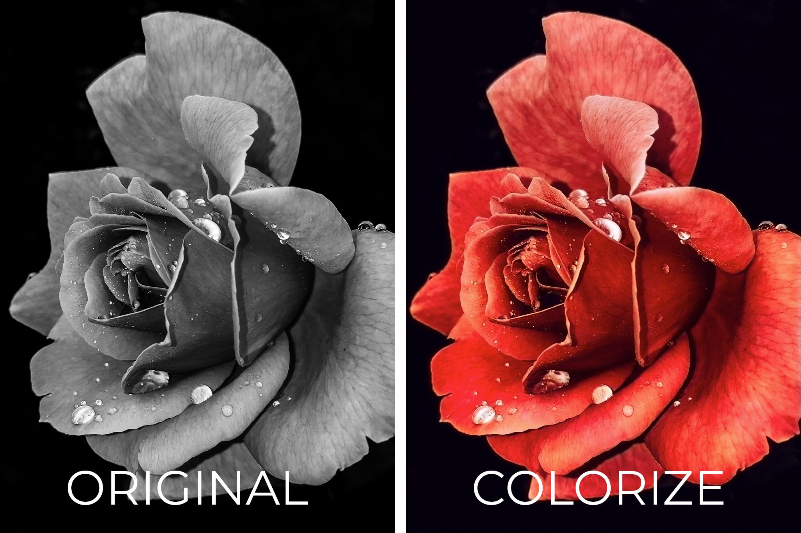
ScanApp
By :
Piyush Kumar Saini (MT23057)
Manish Kumar (MT23044)

Slide 2
Outline
Problem Statement
Activity 1
Activity 2
Server Side
Future Scope

Slide 3
Problem statement
This project aims to develop a mobile application that captures images using a smartphone's camera, sends them to a custom-designed API on a server, and receives processed images and display back to user.

Slide 4
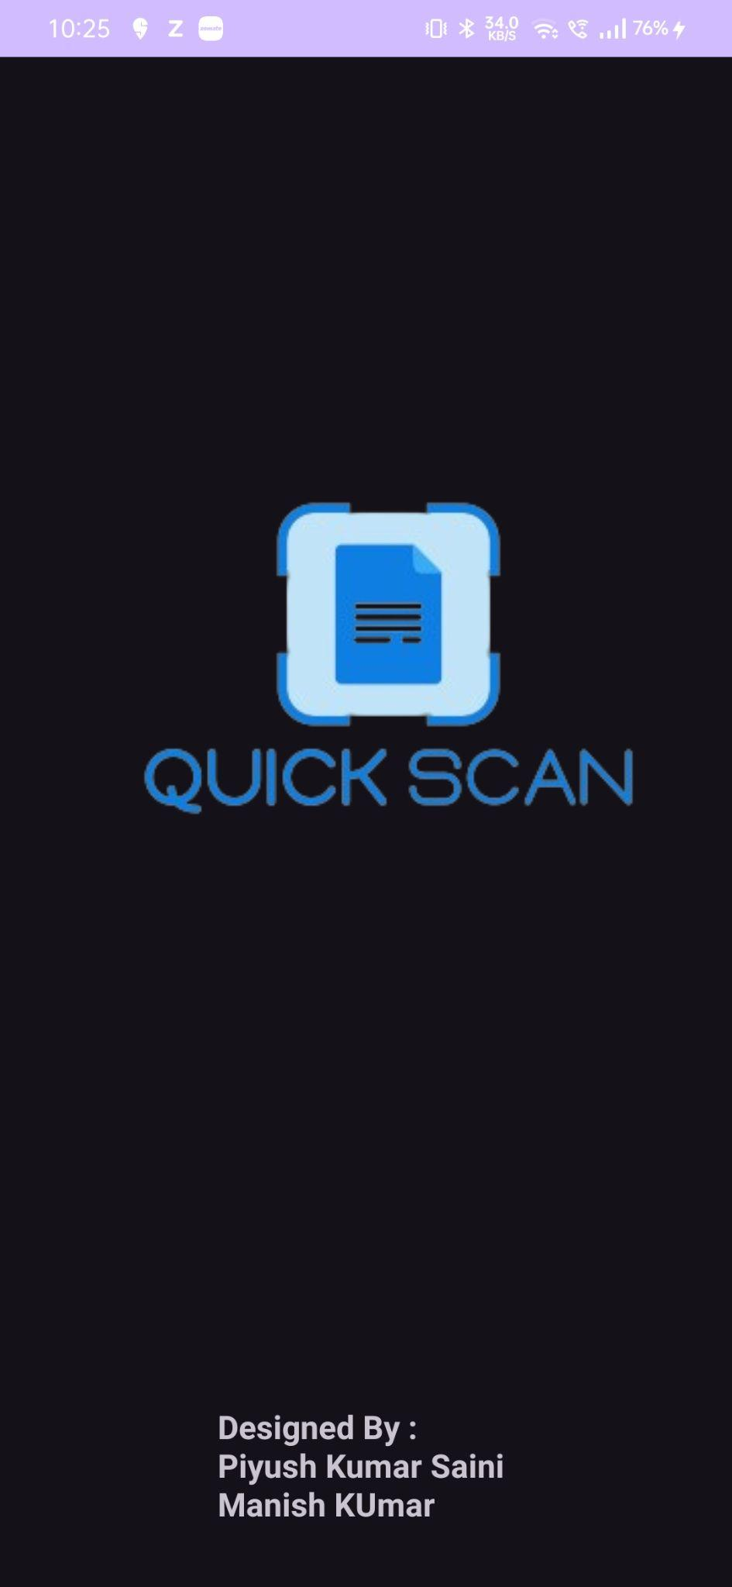
Activity 1
-> Activity 1 is our flash screen.
-> In this Activity we have displayed a welcome page for the user which shows our App name.
-> For functioning of our Activity and task we have required several permissions.
*The application requests camera access (android.permission.CAMERA) to enable capturing photos directly through the device's camera.
*Internet access (android.permission.INTERNET) is required to facilitate network communications for sending images to and receiving data from the server.
-> We have declared in the manifest the use of the device’s camera hardware (android.hardware.camera).

Slide 5
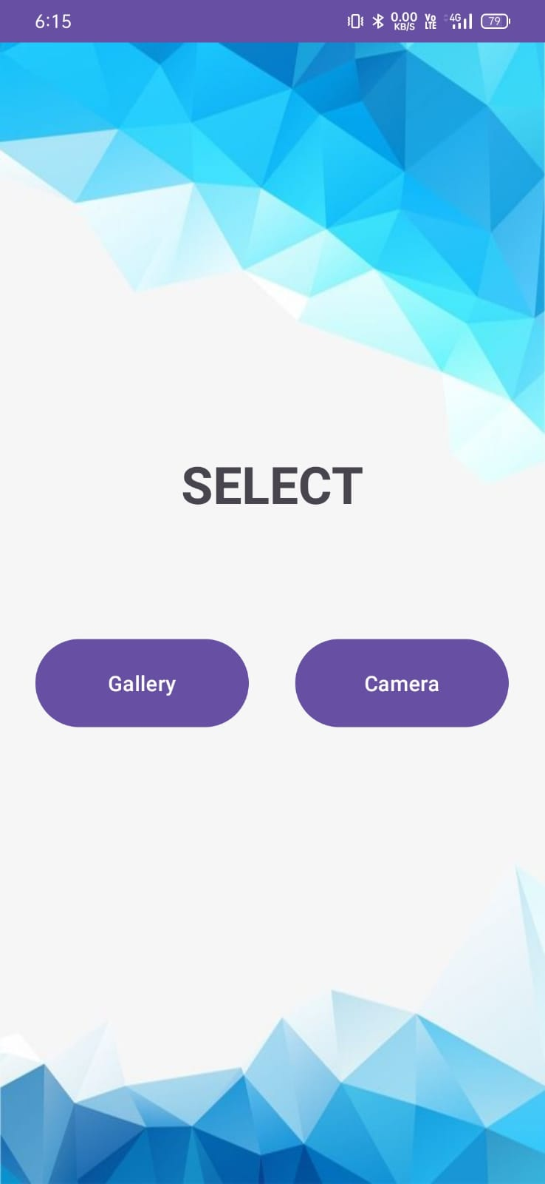
Activity 2
In this Activity 2 we have provided a choice to the user , to select or click an image for processing on the basis of his requirement by providing a button for each choice that will lead to next activity as per requirement.

Slide 6
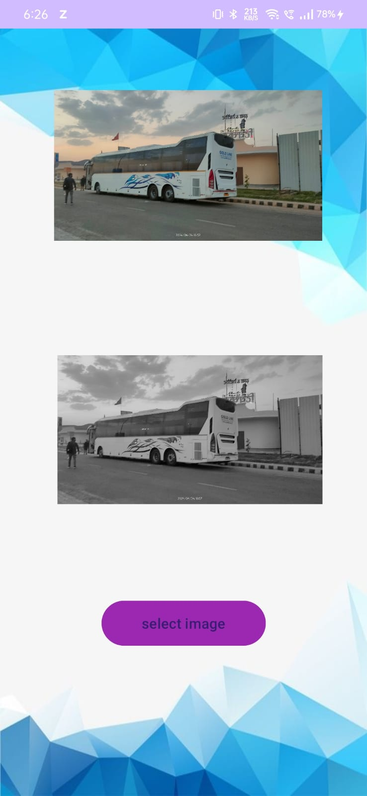
Activity 3 & 4
Activity Layout: We sets up two `ImageView` components (`imgView` for the original image and `img_after_process` for the processed image).
Image Selection and Capture: Implements functionality to either pick an image from the device's storage or capture an image using the device's camera.
Image Processing: Converts the selected or captured image into a byte array and sends it to a server-side API (configured through Retrofit) for processing.
Async Tasks with Coroutines:Uses Kotlin coroutines (`GlobalScope.launch(Dispatchers.IO)`) for performing network operations asynchronously to avoid blocking the UI thread.
API Communication:Utilizes Retrofit for making HTTP requests. The code defines an interface (`ApiService`) presumably elsewhere in the project that handles image processing API calls.

Slide 7
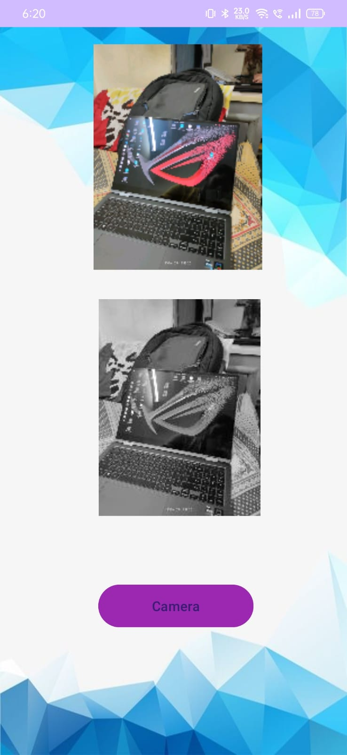
Base64 Image Encoding:Handles the processed image by decoding a Base64 encoded string received from the server and displays it in the `img_after_process` ImageView.
Result Handling: Manages the result from image selection or camera capture intents, processing the image accordingly and updating the UI.
Data Model: Includes a data class (`Preprocessed Image Response`) for parsing the processed image URL from the JSON response, annotated with `SerializedName` to map JSON field names to Kotlin properties.

Slide 8
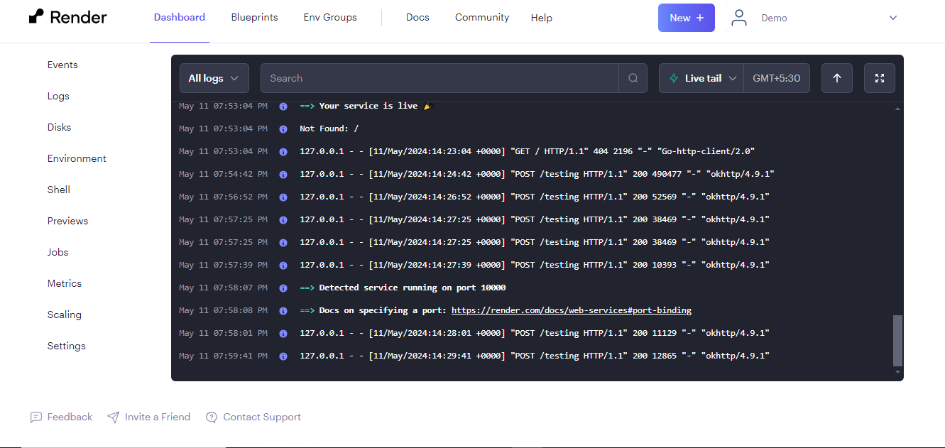
Server Side Programming
->For server side programming we have created a Python-Django based API backend and it is performing below functionality:-
->For request mapping we have created request handling end point as name “testing”.
->This Django view function preprocess_image is designed to handle the preprocessing of uploaded images.
->It accepts image files via a POST request and preprocesses them by converting them to black and white using the Python Imaging Library (PIL).
->The Preprocessed image is then encoded as a base64 string and returned as a JSON response containing the processed image URL.
->And this deployed to free web service provided environment for easily accessing and for functioning with help of Github.

Slide 9
Future Scope
1
-> We can implements some more features like:
Object Recognition.
Format conversion (jpg to png).
Image Blurring.
Background cleaning.

Slide 10
Thank You

